Slide 1
NarVis: Demo

Slide 2
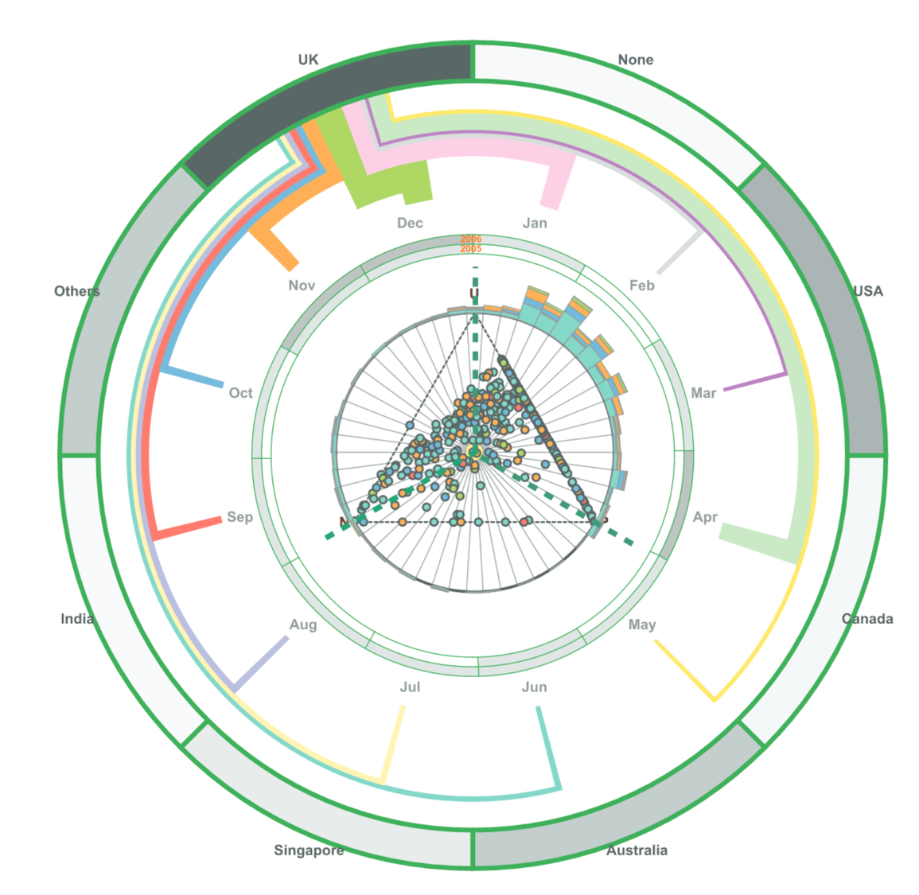

Slide 3
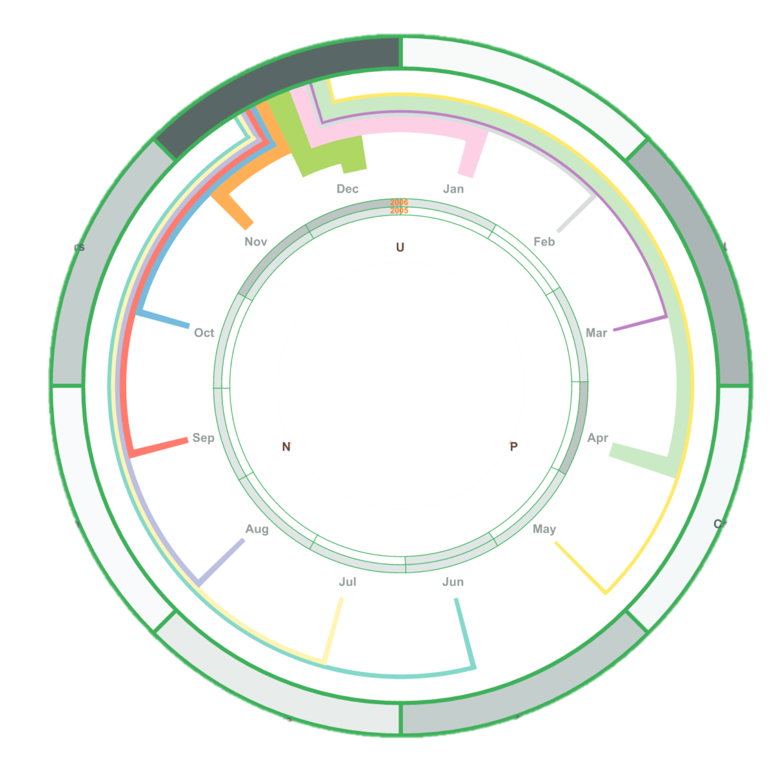
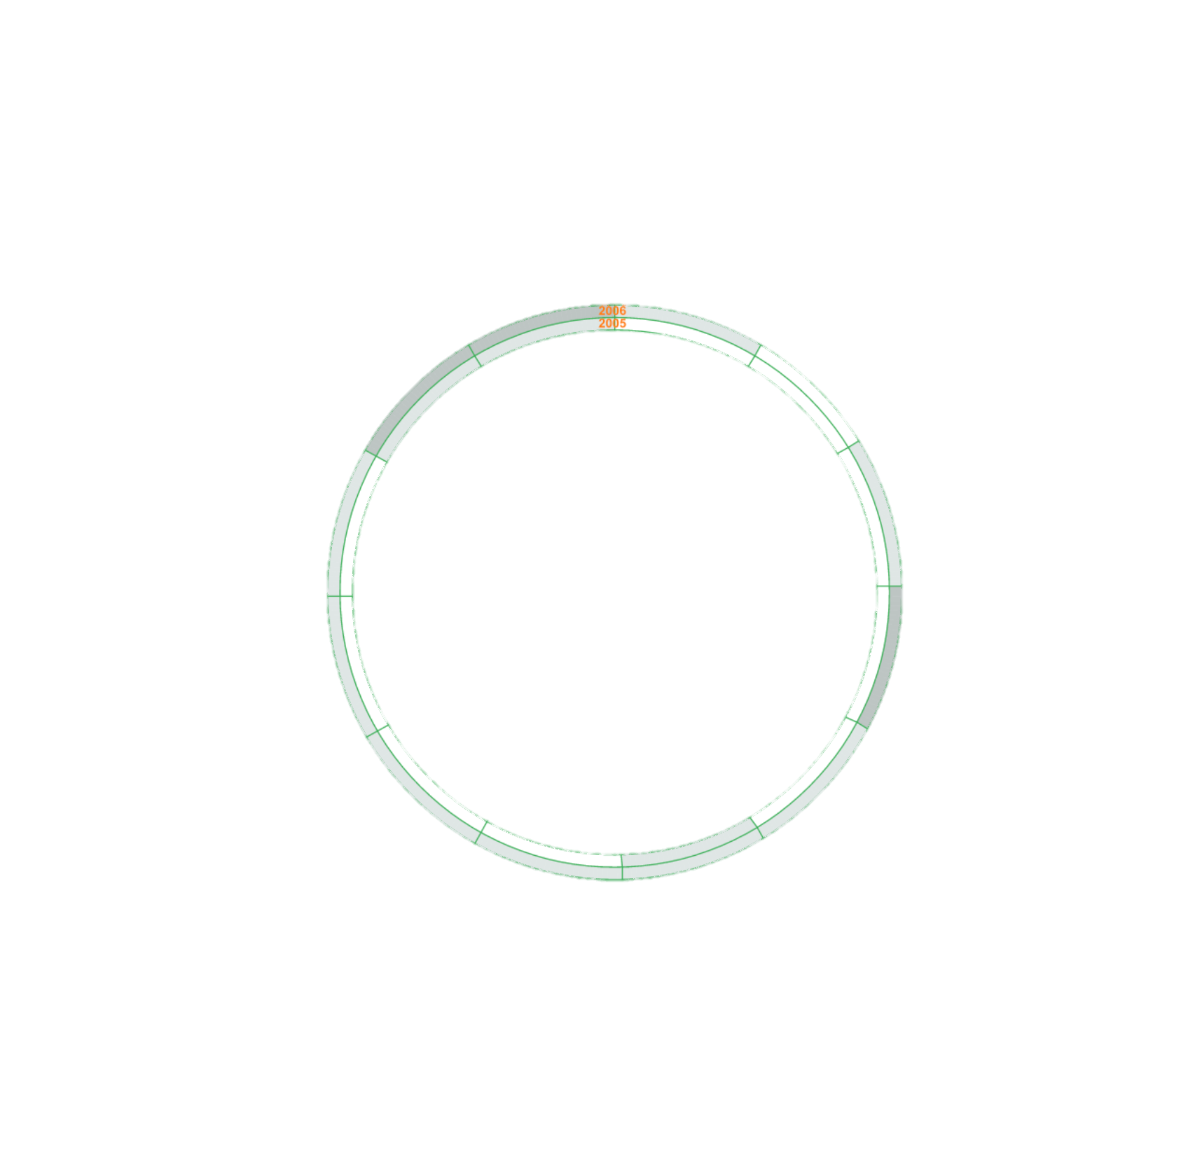
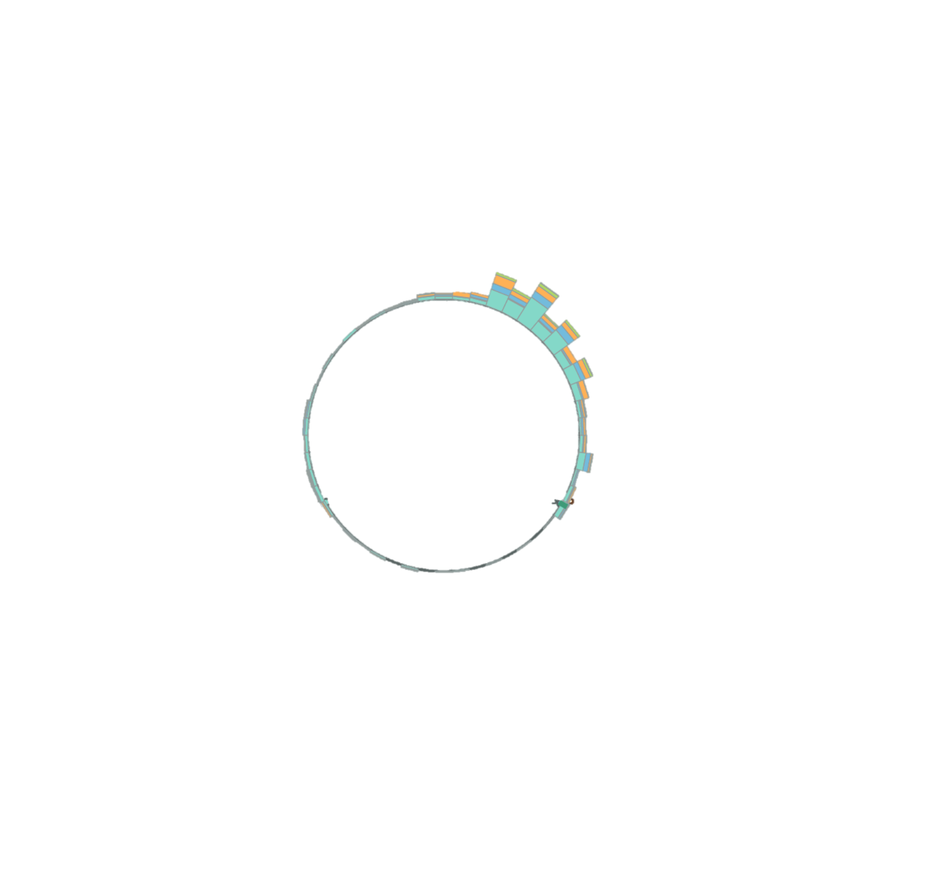
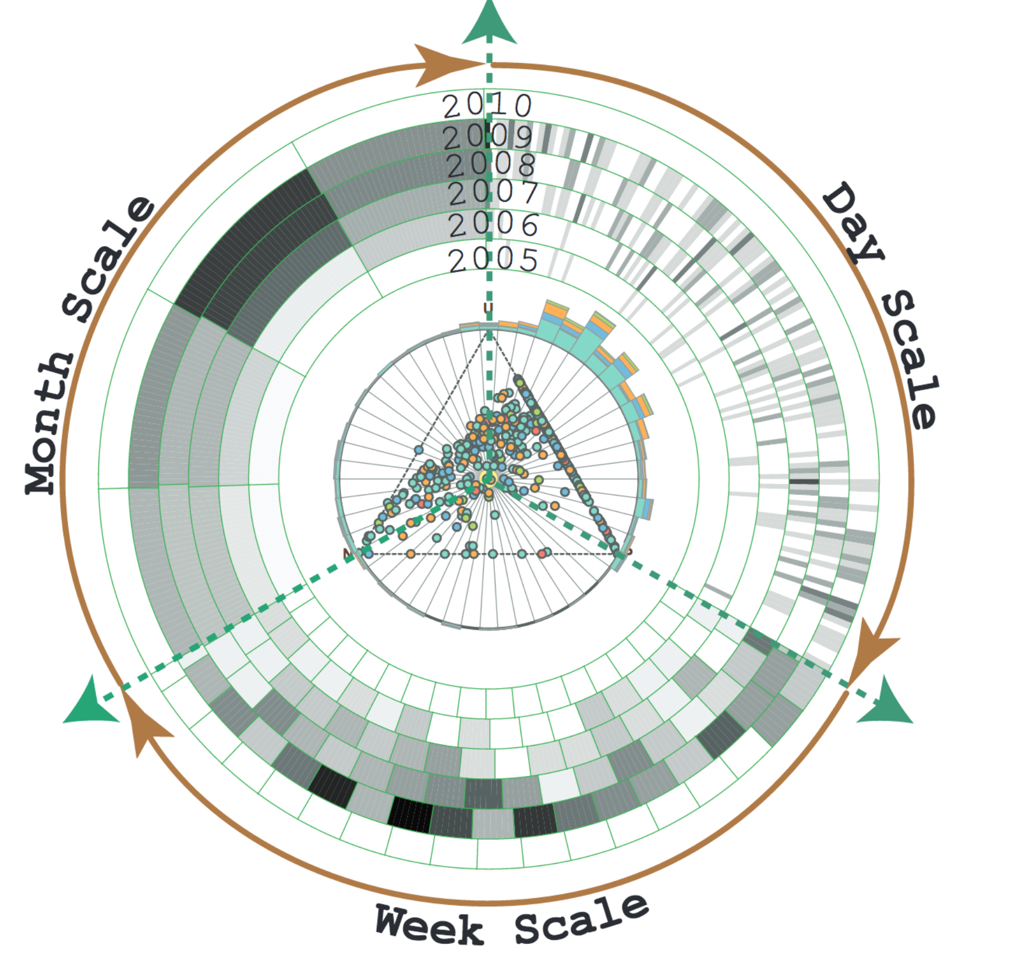

Slide 5
Triangle scatter plot
Opinion wheel
Stacked bar chart
Logic independency
Enhancement
Calendar ring
Geo ring
Logic
dependency

Slide 6
Opinion wheel
Stacked bar chart
Calendar ring
Triangle scatter plot
Geo ring

Slide 7
Opinion wheel
Stacked bar chart
Mark,
Position,
Color
Calendar ring
Geo ring
Triangle scatter plot

Slide 8
Opinion wheel
Stacked bar chart
Calendar ring
Triangle scatter plot
Geo ring

Slide 9
Triangle scatter plot
Opinion wheel
Stacked bar chart
Calendar ring
Geo ring

Slide 10
Triangle scatter plot
Opinion wheel
Calendar ring
Geo ring
Stacked bar chart

Slide 11
Triangle scatter plot
Opinion wheel
Stacked bar chart
Calendar ring
Geo ring

Slide 12
Triangle scatter plot
Stacked bar chart
Calendar ring
Geo ring
Opinion wheel

Slide 13
Triangle scatter plot
Opinion wheel
Stacked bar chart
Calendar ring
Geo ring

Slide 14
Triangle scatter plot
Opinion wheel
Stacked bar chart
Geo ring
Calendar ring

Slide 15
Triangle scatter plot
Opinion wheel
Stacked bar chart
Calendar ring
Geo ring

Slide 16
Triangle scatter plot
Opinion wheel
Stacked bar chart
Calendar ring
Geo ring

Slide 17
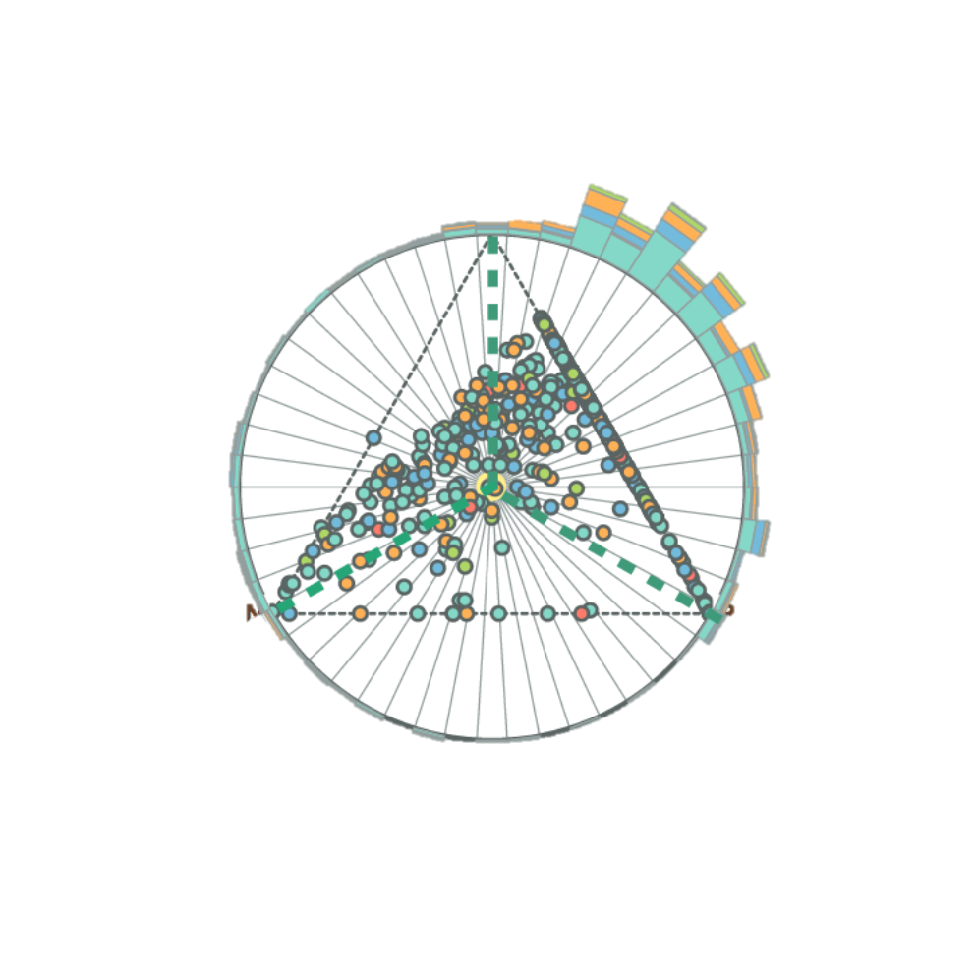
Triangle scatter plot
Opinion wheel
Stacked bar chart
Calendar ring
Geo ring

